Slide 1
Project Analysis Clustering Assignment
HELP International NGO

Slide 2
Problem Statement
We need to categorize the countries using some socio-economic and health factors that determine the overall development of the country. Then we need to suggest the countries which the CEO needs to focus on the most. And help them use this $ 10 million strategically and effectively.
About:
HELP International is an international humanitarian NGO that is committed to fighting poverty and providing the people of backward countries with basic amenities and relief during the time of disasters and natural calamities. It runs a lot of operational projects from time to time along with advocacy drives to raise awareness as well as for funding purposes.

Slide 3
Project analysis slide 2
Project Analysis
Data Quality Check
Finding best value of k:
SSD, Silhoutte Score
EDA
KMeans Analysis using final value of k
Steps
Outlier Treatment
Visualize the cluster
Hopkin's Test
Cluster profiling
Scaling The Data
Hierarchical Clustering

Slide 4
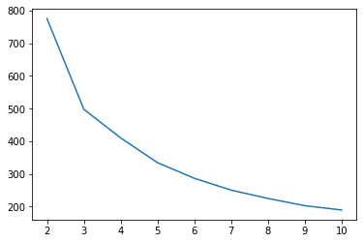
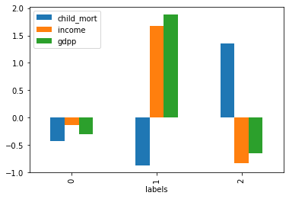
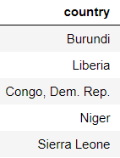
Project analysis slide 6
Kmeans Clustering
SSD, Silhoutte Score suggests that k=3 will be good for clustering.
Child_mort data was too low to be visible in graph for main dataframe, so tried bar graph for scaled dataframe.
Top 5 countries from the cluster 2 as it have low income, low gdpp and high child mortality rate

Slide 5
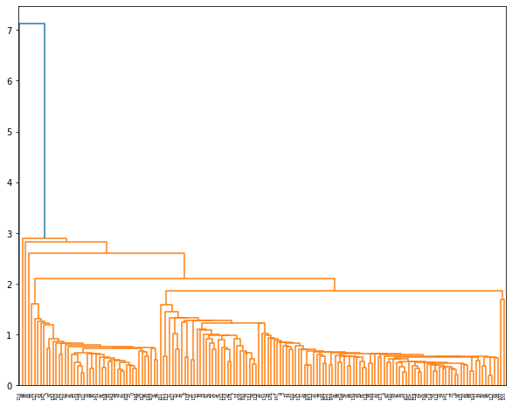
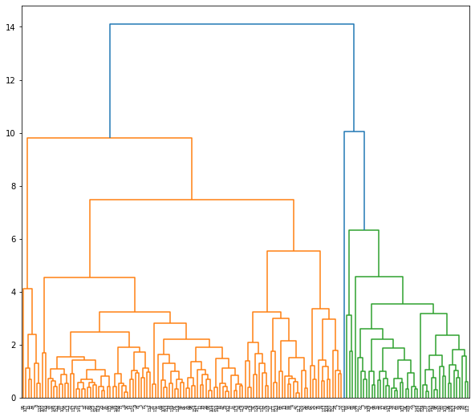
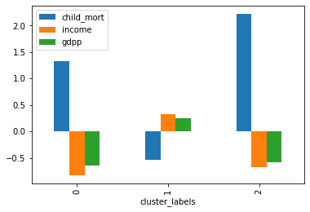
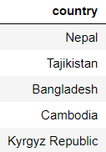

Project analysis slide 6
Hierarchical Clustering
Single linkage dendogram suggests to cut at 3 where we will get 2 clusters..
The complete linkage dendogram suggests us that we need to cut at 10 and we will get 3 clusters.
Child_mort data was too low to be visible in graph for main dataframe, so tried bar graph for scaled dataframe.
Cluster 2 has only one country in it. So, lets check cluster 1.
Cluster 1 has these countries

Slide 6
Thank You

